Slide 1
Black Friday Sales Prediction

Slide 2
Problem statement
A retail company “ABC Private Limited” wants to understand the customer purchase behaviour (specifically, purchase amount) against various products of different categories. They have shared purchase summary of various customers for selected high volume products from last month. The data set also contains customer demographics (age, gender, marital status, city_type, stay_in_current_city), product details (product_id and product category) and Total purchase_amount from last month.
Now, they want to build a model to predict the purchase amount of customer against various products which will help them to create personalized offer for customers against different products.

Slide 3
Data Characteristics
Feature | Feature type | Description
User_ID | Numerical, Integer | Unique id for each row
Product_ID | Categorical, Nominal | Unique id for each product
Gender | Categorical, Nominal | Gender of the customer
Age | Categorical, Ordinal | Age of the customer
Occupation | Numerical, Integer | Occupation of the customer
City_Category | Categorical, Nominal | Category which customer’s city belongs to
Stay_In_Current_City_Years | Categorical, Ordinal | No. of years customer stayed in current city
Marital_Status | Numerical, Integer | Marital status of the customer

Slide 4
Feature | Feature type | Description
Product_Category_1 | Numerical, Integer | Different product categories varying between 1 and 20
Product_Category_2 | Numerical, Float | Different product categories varying between 2 and 18
Product_Category_3 | Numerical, Float | Different product categories varying between 3 and 18
Target variable | Target type | Description
Purchase | Numerical, Integer | Purchase value for each customer

Slide 5
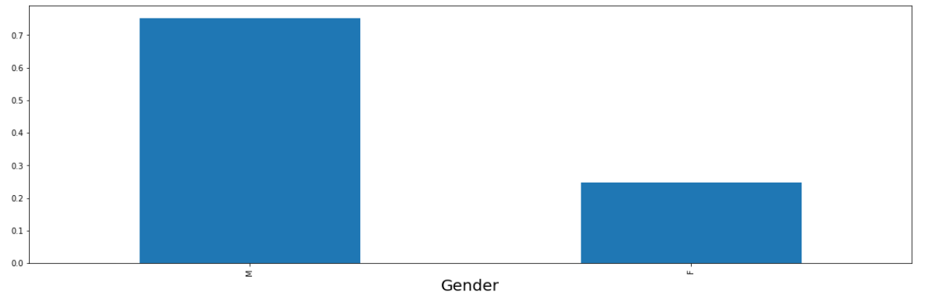
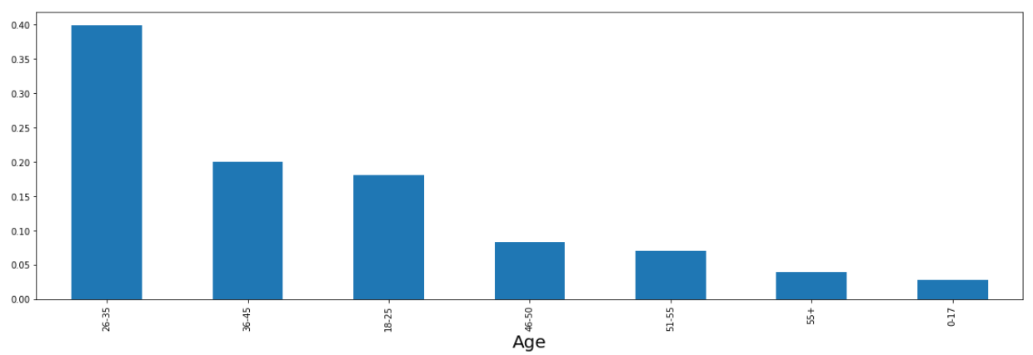
Exploratory Data Analysis
When checked for missing values, the columns Product_Category2 and Product_Category3 had 69% and 31% of missing values.
The missing values have been filled with zeroes.
Univariate analysis of Categorical data:
We can see that the data consists of maximum male customers.
Most of the customer belong to the age group 26-35

Slide 6
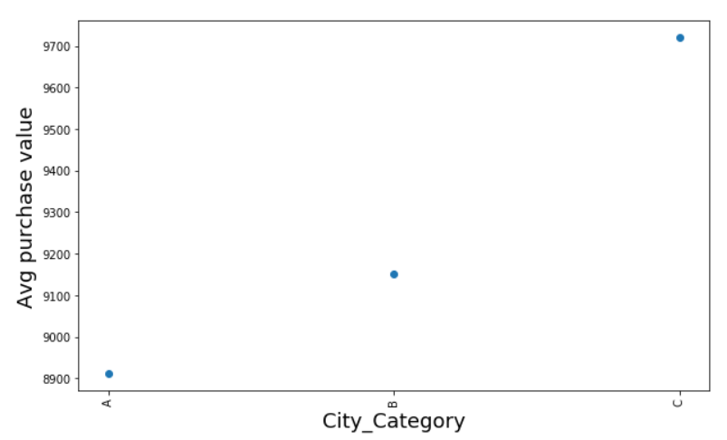
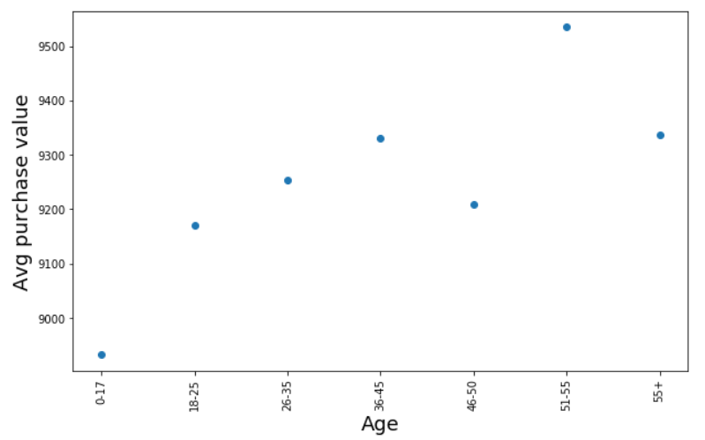
Bivariate analysis of Categorical data:
The average purchase value is varying from male to female by 700$
Max avg purchase value is made by the people in the age group of 51-55. As the age increases the avg amount spent is also increasing and when the age bcomes 55+ the purchase value comes down.
Though the customers who belong to city B is higher, the avg purchase value made by the customer belonging to city C is more.

Slide 7
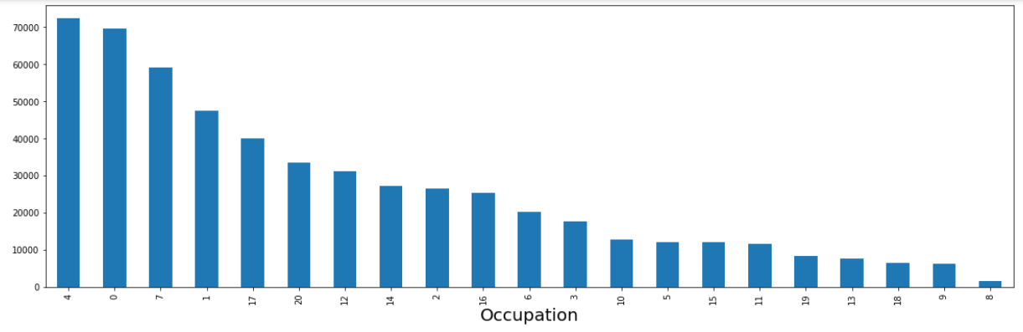
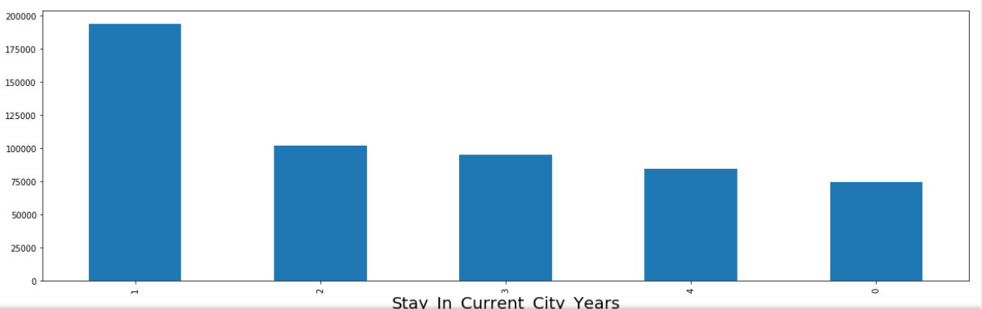
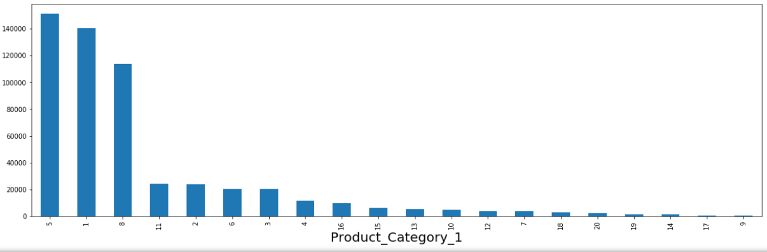
Univariate analysis of Continuous data:
The product Category 1,5 and 8 are being purchased in high quantities compared to other categories
Majority of the users belong to the occupations 4,0,7 and 1

Slide 8
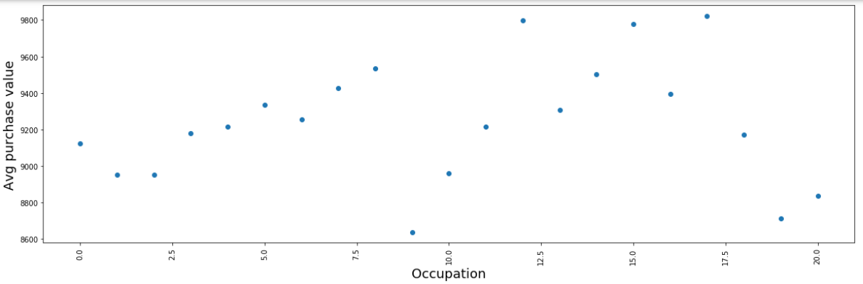
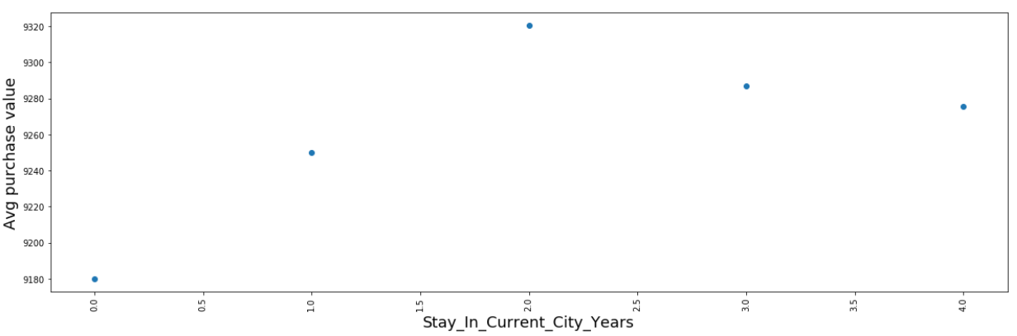
Bivariate analysis of Continuous data:
Users with occupation 12,15,17 have made max avg purchase value.
People who have stayed in current city for more than a year have made more purchases comparatively

Slide 9
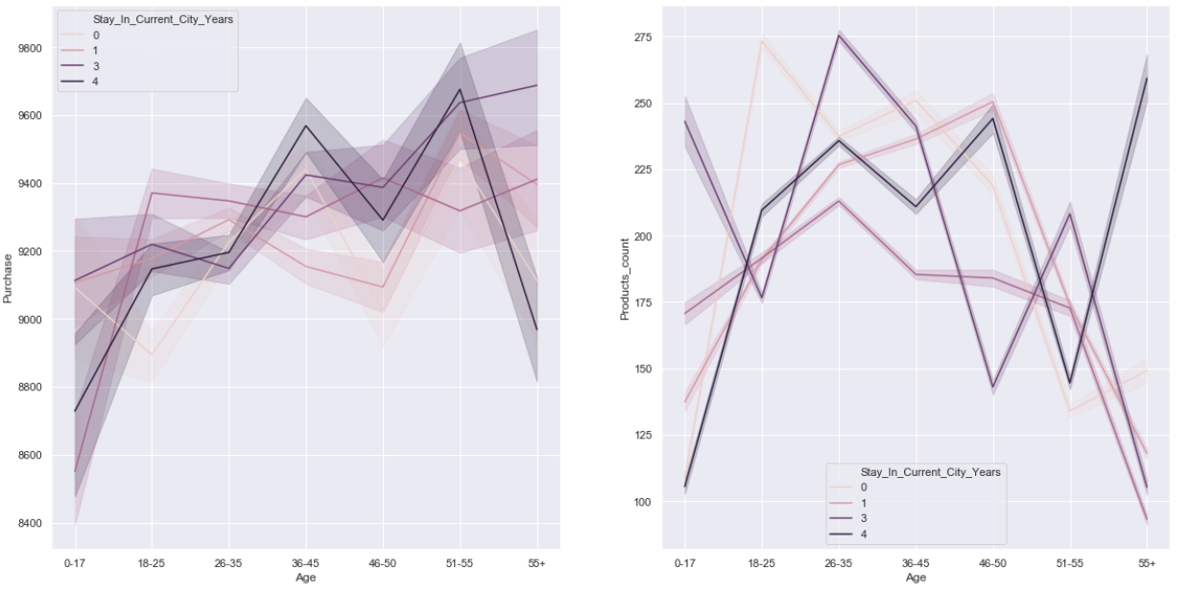
Relationship between Age vs Total Purchase/Products count:
People aged 50+ who are settled in the city for 3-4 years are making max purchase values, after they stayed for 4+ years the purchase values dropped rather too much but the products count has increased. So they must be choosing rather less costly items after staying for 4+ years
The purchase value of the people who are staying in the city for 3 years keeps increasing with the age.

Slide 10
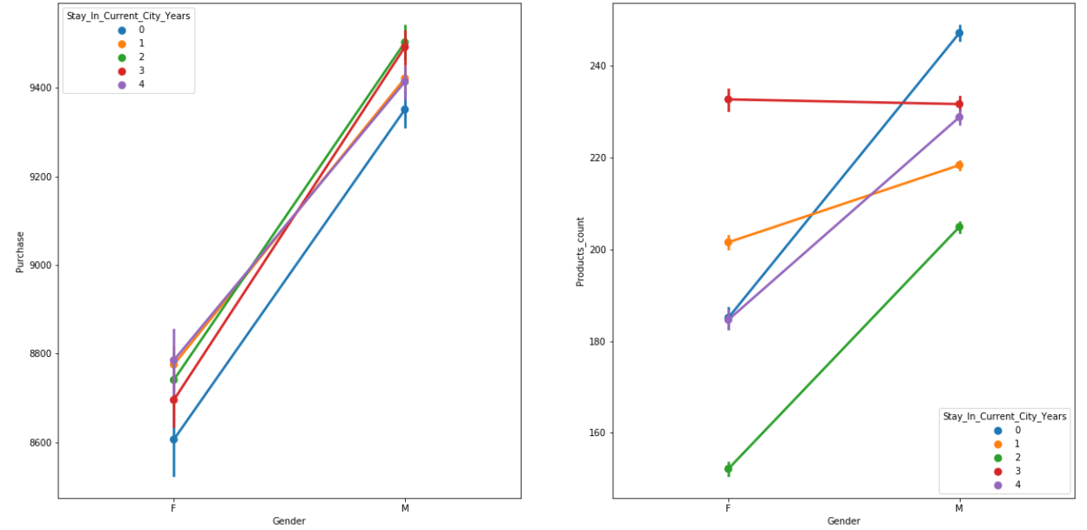
Relationship between Age vs Total Purchase/Products count:
Though the max purchase value is always greater for Male we can observe the number of products bought by female for stay in current city years '3' is greater.

Slide 11
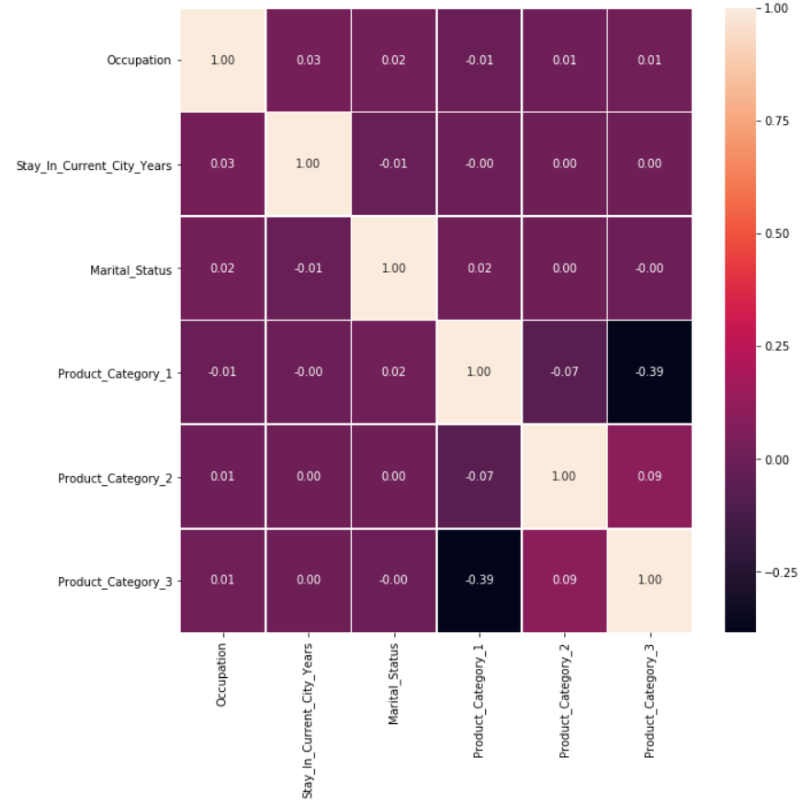
Feature Correlation
No significant correlation observed between the numerical features.
Hence decided to retain all the features.

Slide 12
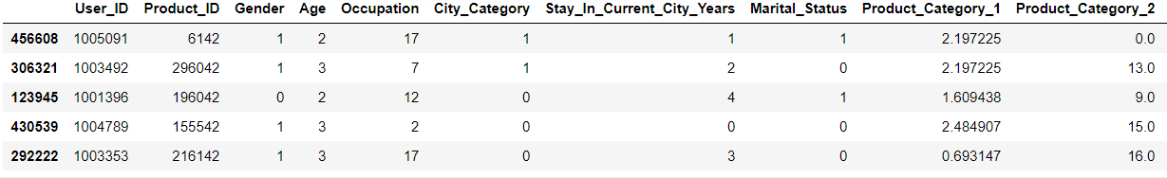
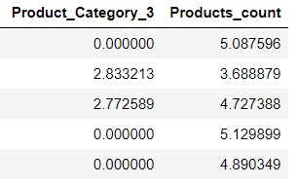
Encoding, Data transformation and Feature Engineering
Label Encoding was done on all the categorical features.
As some of the numerical features were right skewed, applied np.log on those features to reduce the skewness.
Dropped the columns User_Id and Product_Id as these features are unique.
Feature engineered ‘Products_count’ for each customer as this feature would be useful for prediction of purchase value.

Slide 13
Data Modelling
Model | RMSE value
Linear Regression | 4459
Ridge regression | 4460
Random Forest Regressor | 2923
DecisionTree Regressor | 2945
XGBoost Regressor | 2803
XGBoost Regressor is the best model with least RMSE value followed by Decision Tree Regressor among all models.

Slide 14
Thank you

